Slide 1
Implementing RAG to Chat with your emails
Rohit Parthiban Kushhal Sathish

Slide 2
Scope
Large Language Models (LLMs) are advanced AI systems designed to process and generate human-like text by learning from extensive datasets. Uses: tasks such as language translation, text summarization, and conversational responses,etc. LLM - visibility - the data which is pre-trained. Mitigation - Using RAG’s (Retrieval Augmented Generation)
Usecase: Getting user query response from LLM by adding email data.

Slide 3
RAG’S
Definition:
RAG (Retrieval-Augmented Generation) is a hybrid AI approach that combines a retrieval system with a generative language model to produce accurate and contextually relevant responses.
How it Works:
Input Query:
User submits a question or prompt. -> (vector embeddings)
Retrieve Step:
The retriever searches for related content from an indexed knowledge source.
Generate Step:
The LLM uses the retrieved information to construct a detailed, accurate response.
Output:
The system delivers a generated answer augmented by reliable, retrieved knowledge.

Slide 4
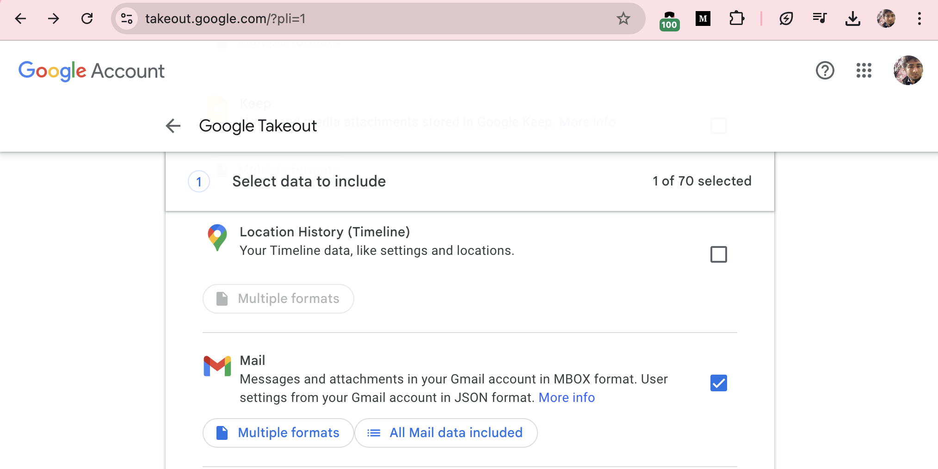

Slide 5
Used Frameworks
Beautiful soup LangChain Chromadb gpt4all

Slide 6
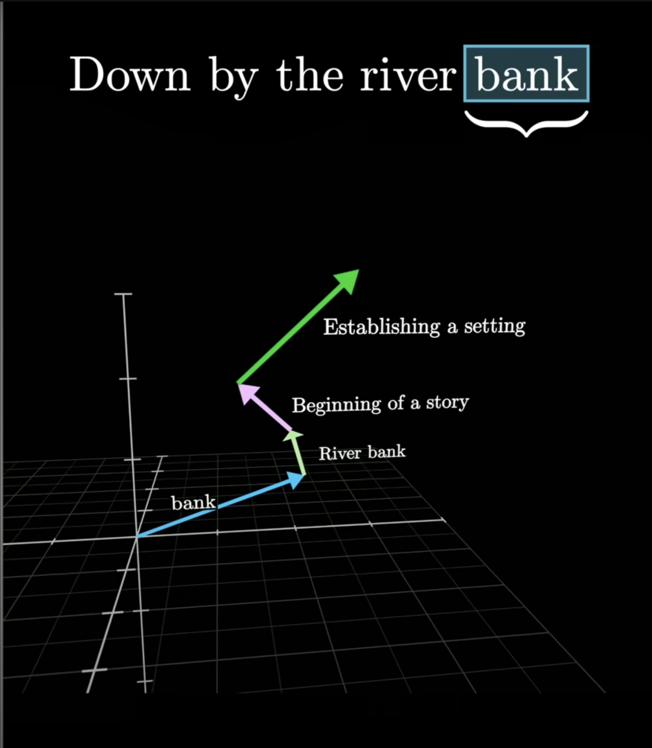
Chroma Vector Store (SEQ)

Slide 7
FineTuning Gemma
If using fine-tuned model, quantize to GGUF Format
For quantizing, we can either:
Use the llama.cpp library written in C,C++ for this. Or we can use LangChain's functionality.

Slide 8
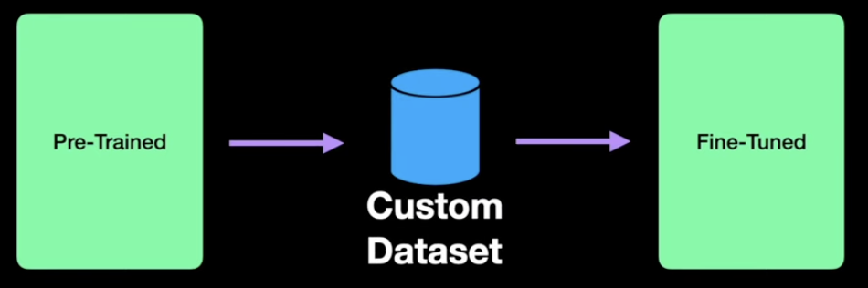
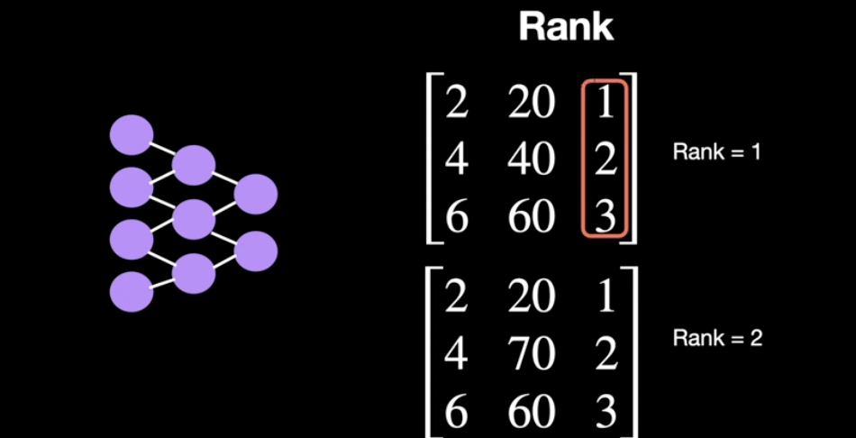
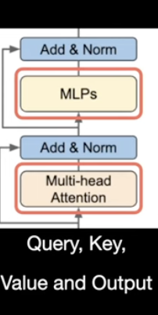
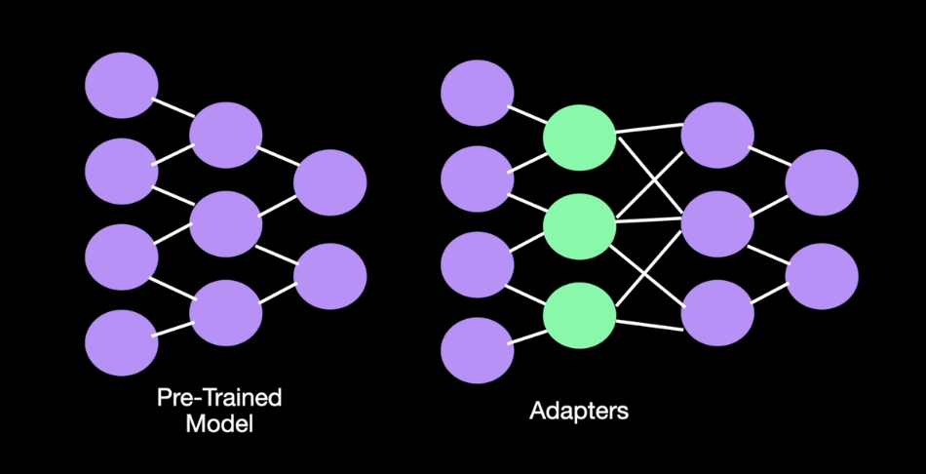
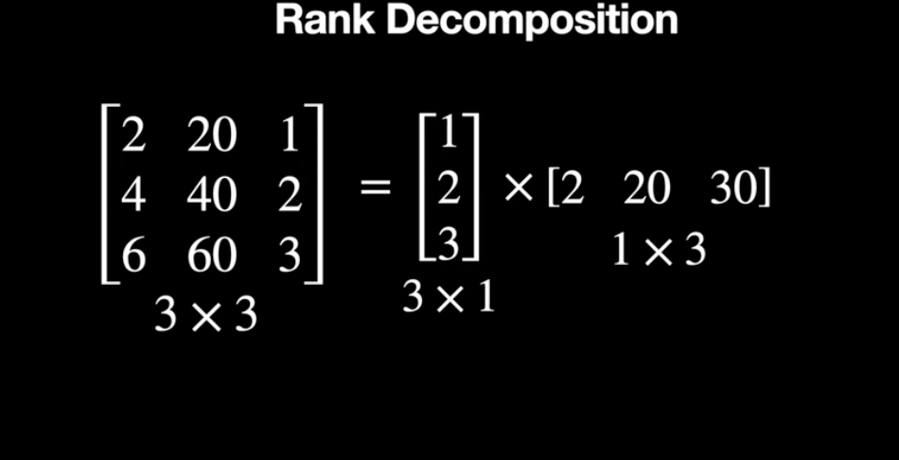
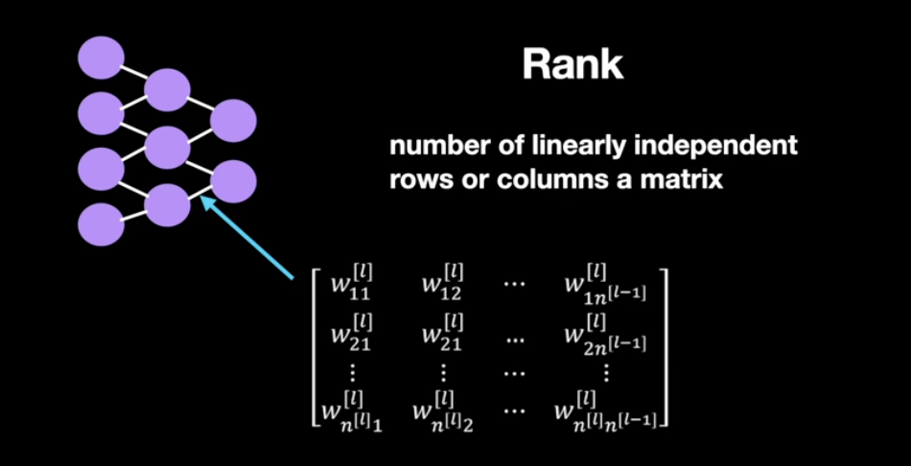
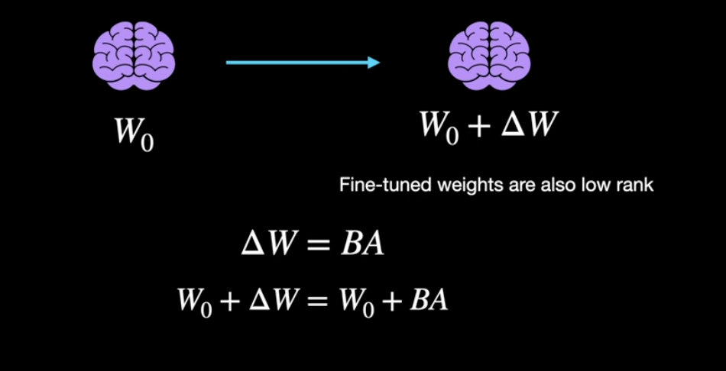
LoRA (Low-rank Adaptation of AI Large Language Models) for fine-tuning LLM models

Slide 9
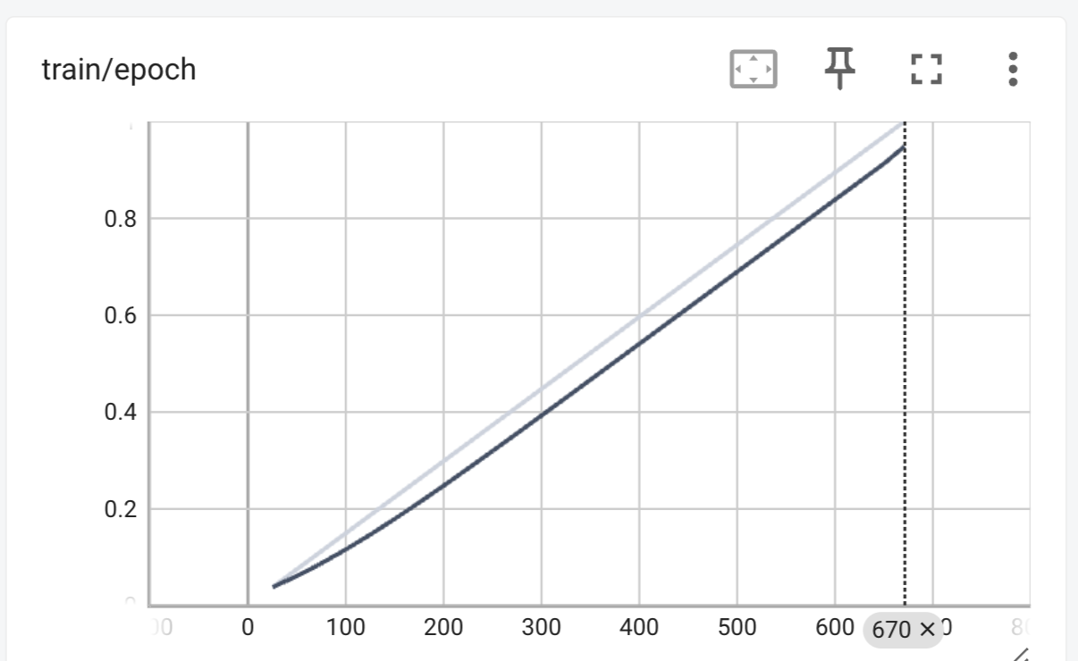

Slide 10
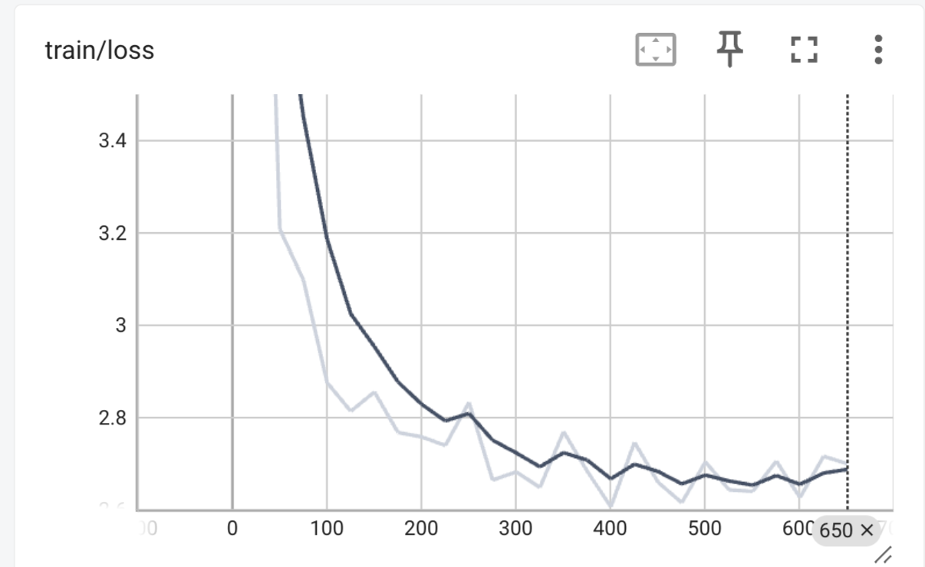

Slide 11
